Slide 1
A note on paragraph structure

Slide 2
A note on paragraph structure
A pattern that can be identified in many well-written paragraphs is that of a controlling idea followed by supporting information. The controlling idea, sometimes referred to as the topic sentence, introduces a new idea, topic, argument or piece of information into the main text. This is then either explained further or supported by subsequent sentences. This structure can be represented schematically thus:

Slide 3
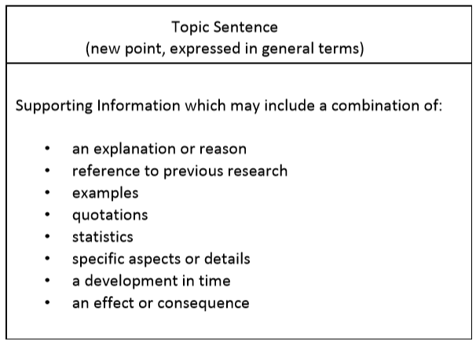

Slide 4
It is important that the explanatory or supporting information in a paragraph should relate to the topic sentence. If new points or ideas are to be stated, then these should be treated in a separate paragraph. It is also important that the explanatory or supporting information should not repeat the general ideas expressed in the topic sentence.

Slide 5
An example of the kind of paragraph structure suggested above is given below. Note the development from the general idea to the more detailed information. Also note the thematic linking, which is signalled by the words in bold, between the sentences. Each of these words and phrases links back to an idea introduced in the previous sentence. Here, the sentences have been separated.

Slide 6
